Slide 1
DNA To Protein
Let’s Go Know more about Translate DNA to Protein.!!

Slide 2
Agenda
Introduction
Transcription
Transcription function
Translation
Translation function
Protein
Protein function
Video
Practical project
References

Slide 3
Introduction
Genetics has become a major science.
When linking any major science to programming, it helps scientists or researchers to study.
So, we want to link between genetics and programming.
Through specific programs, we can easily follow a sequence of DNA.
So, we will show how to getting proteins from sequences of DNA.

Slide 4
Introduction
In programming, DNA is the input and we will make some process on it and generate the protein (output).
DNA process Protein

Slide 5
Transcription

Slide 6
What is Transcription of DNA ??
- Hey Every Body !
Let me take about “Transcription of DNA”…
Transcription is the process by which the information in a strand of DNA is copied into a new as a refemolecule of messenger RNA (mRNA). DNA safely and stably stores genetic material in the nuclei of cells rence, or template.
Transcription is carried out by an enzyme called RNA polymerase and a number of accessory proteins called transcription factors. Transcription factors can bind to specific DNA sequences called enhancer and promoter sequences.

Slide 7
What is The purpose From Transcription of DNA ?
01
02
03
04
The goal of transcription is to make a RNA copy of a gene's DNA sequence.
carries the information needed to build a polypeptide (protein or protein subunit)
Use a strand of DNA to build a molecule of mRNA
Use a mRNA to build an amino acid chain

Slide 8
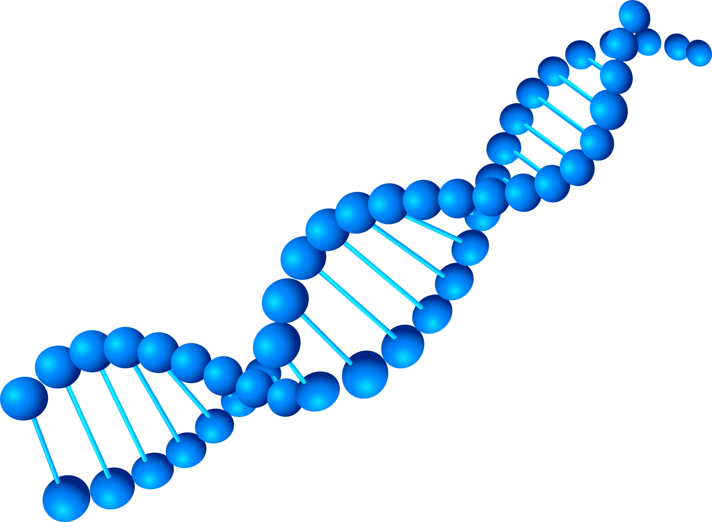
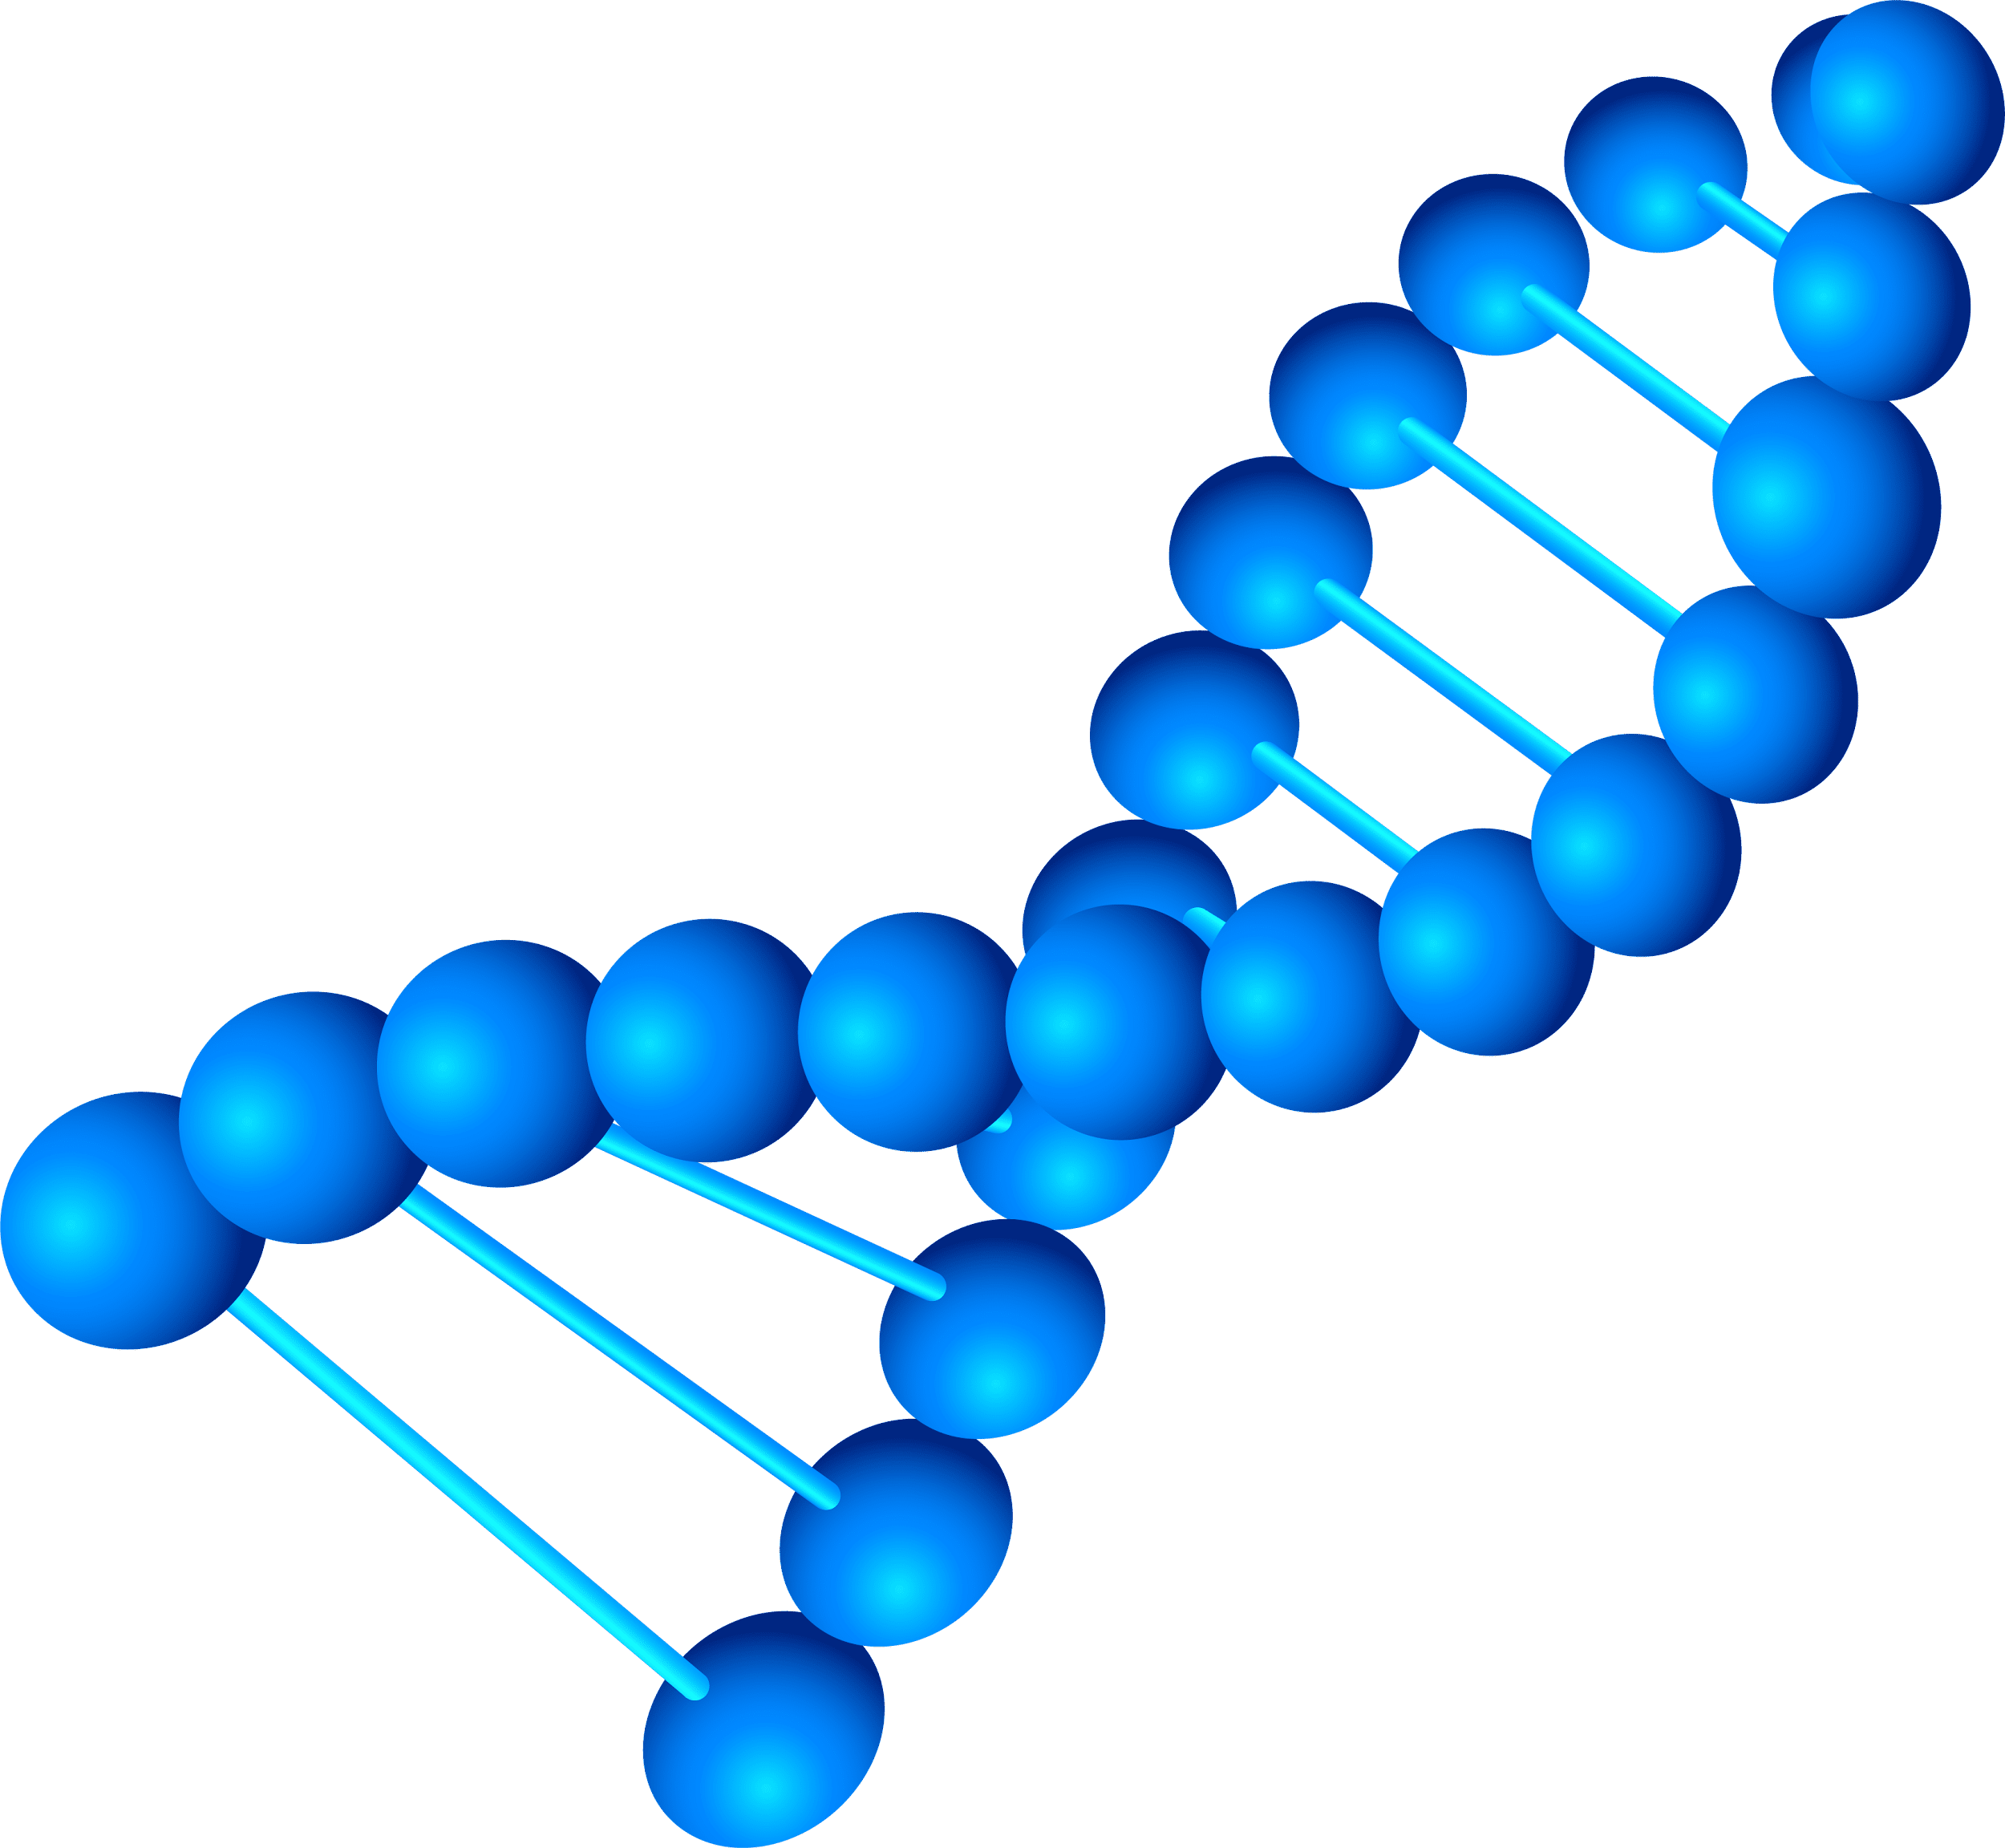
Where is the transcription of DNA happen??
Transcription takes place in the nucleus. It uses DNA as a template to make an RNA (mRNA) molecule. During transcription, a strand of mRNA is made that is complementary to a strand of DNA.
the process of Using strand of DNA to build a molecule of mRNA happen in Nucleus and the process of Using a mRNA to build an amino acid chain happen in Cytoplasm

Slide 9
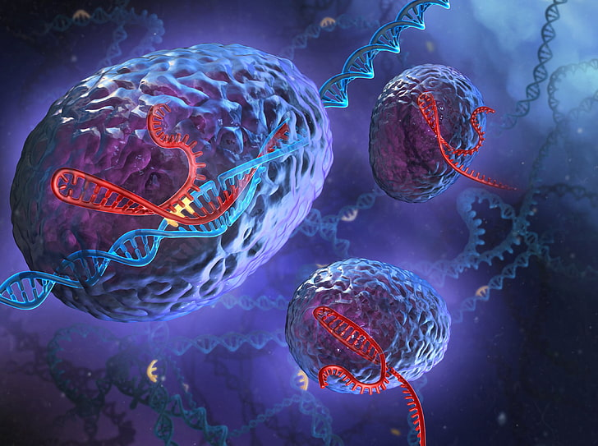
Attention please!!!
There is two types of the cells :
Eukaryotes cells
Prokaryotes cells (Bacterial Cells)
- Let me show how the transcription
of DNA happen in both..

Slide 10
First DNA transcription in Eukaryotes
Eukaryotic transcription
is the elaborate process that eukaryotic cells use to copy genetic information stored in DNA into units of transportable complementary RNA replica.
Unlike prokaryotic RNA polymerase that initiates the transcription of all different types of RNA, RNA polymerase in eukaryotes (including humans) comes in three variations,
each translating a different type of gene.
A eukaryotic cell has a nucleus that separates the processes of transcription and translation. Eukaryotic transcription occurs within the nucleus where DNA is packaged into nucleosomes and higher order chromatin structures.

Slide 11
Second DNA transcription in Prokaryotes
Transcription in prokaryotes (as in eukaryotes) requires the DNA double helix to partially unwind in the region of RNA synthesis. The region of unwinding is called a transcription bubble. Transcription always proceeds from the same DNA strand for each gene,
which is called the template strand. The RNA product is complementary to the template strand and is almost identical to the other (non-template) DNA strand,
called the sense or coding strand. The only difference is that in RNA all of the T nucleotides are replaced with U nucleotides.
The nucleotide on the DNA template strand that corresponds to the site from which the first 5′ RNA nucleotide is transcribed is called the +1 nucleotide, or the initiation site.

Slide 12
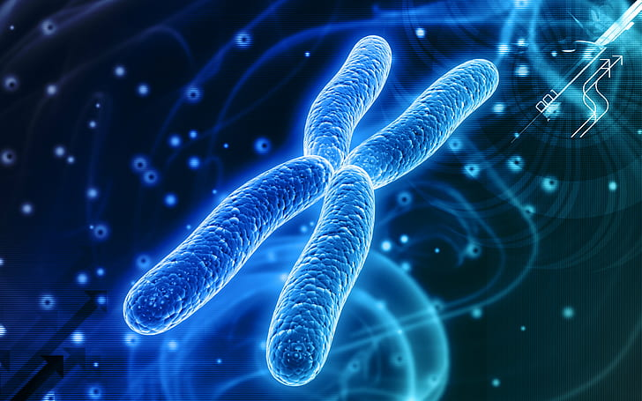
What is the steps of transcription DNA??

Slide 13
Our Steps
Step 1: Initiation
Initiation is the beginning of transcription. It occurs when the enzyme RNA polymerase binds to a region of a gene called the promoter. the enzyme can ‘‘read’’ the bases in one of the DNA strands.
Step 2: Elongation
Elongation is the addition of nucleotides to the mRNA strand. RNA polymerase reads the unwound DNA strand and builds the mRNA molecule, using complementary base pairs.
Step 3: Termination
Termination is the ending of transcription, and occurs when RNA polymerase crosses a stop (termination) sequence in the gene. The mRNA strand is complete.

Slide 14
#---Transcription code---#
#Sequence of DNA
seq_DNA = "TAC GGC ATA“
#Transcription Function
def transcription (dna):
mRNA = " "
for i in dna:
if i == 'A':
mRNA += 'U'
elif i == 'T':
mRNA += 'A'
elif i == 'C':
mRNA += 'G'
elif i == 'G':
mRNA += 'C'
elif i == ' ':
mRNA += ' '
else:
print("Invalid")
return mRNA
seq_mRNA = transcription(seq_DNA)
print("The sequence of mRNA is [" + seq_mRNA + "]")

Slide 15
Translation

Slide 16
Overview of translation: - How is an mRNA "read" to make a polypeptide? Two types of molecules with key roles in translation are tRNAs and ribosomes. - Translation is the process by which the genetic code contained within a messenger RNA (mRNA) molecule is decoded to produce a specific sequence of amino acids in a polypeptide chain. - It occurs in the cytoplasm following DNA transcription and, like transcription, has three stages: initiation, elongation and termination. In this article we will discuss the components and stages of DNA translation

Slide 17
Components of Translation: - During translation, mRNA nucleotide bases are read as codons of three bases. Each codon codes for a particular amino acid. - Every tRNA molecule possesses an anticodon that is complementary to the mRNA codon, and at the opposite end lies the attached amino acid. tRNA molecules are therefore responsible for bringing amino acids to the ribosome in the correct order, ready for polypeptide assembly. - A single amino acid may be coded for by more than one codon. There are also specific codons that signal the start and the end of translation. - Aminoacyl-tRNA synthetases are enzymes that link amino acids to their corresponding tRNA molecules. The resulting complex is charged and is referred to as an aminoacyl-tRNA.

Slide 18
The steps of Translation : - Initiation: For translation to begin, the start codon (5’AUG) must be recognized . This codon is specific to the amino acid methionine, which is nearly always the first amino acid in a polypeptide chain. At the 5’ cap of mRNA, the small 40s subunit of the ribosome binds. Subsequently, the larger 60s subunit binds to complete the initiation complex. The next step (elongation) can now commence. - Elongation: The ribosome has two tRNA binding sites; the P site which holds the peptide chain and the A site which accepts the tRNA.

Slide 19
While Methionine-tRNA occupies the P site, the aminoacyl-tRNA that is complementary to the next codon binds to the A site, using energy yielded from the hydrolysis of GTP Methionine moves from the P site to the A site to bond to a new amino acid there, starting the growth of the peptide. The tRNA molecule in the P site no longer has an attached amino acid, so leaves the ribosome. The ribosome then translocates along the mRNA molecule to the next codon, again using energy yielded from the hydrolysis of GTP. Now, the growing peptide lies at the P site and the A site is open for the binding of the next aminoacyl-tRNA, and the cycle continues. The polypeptide chain is built up in the direction from the N terminal (methionine) to the C terminal (the final amino acid).

Slide 20
TENDENCY
- Termination:
is the stage in which the finished polypeptide chain is released. It begins when a stop codon (UAG, UAA, or UGA) enters the ribosome, triggering a series of events that separate the chain from its tRNA and allow it to drift out of the ribosome.
After termination, the polypeptide may still need to fold into the right 3D shape, undergo processing (such as the removal of amino acids), get shipped to the right place in the cell, or combine with other polypeptides before it can do its job as a functional protein

Slide 21
#---Translation code---#
Sequence of mRNA mRNA = "AUG CCG UAU" #Translation Function def translation(mRna): Anti_codon = " " for i in mRNA: if i == 'A': Anti_codon += 'U' elif i == 'C': Anti_codon += 'G' elif i == 'U': Anti_codon += 'A' elif i == 'G': Anti_codon += 'C' elif i == ' ': Anti_codon += ' ' else: print("Invalid") return Anti_codon # Anti_codons of tRNA tRNA_Anti_Codon = translation(mRNA) print("The anti-codons of tRNA is [" + tRNA_Anti_Codon + "]")

Slide 22
Proteins

Slide 23
Proteins
An important class of molecules that carry out most of the work inside cells.
The building blocks of proteins are smaller organic molecules called amino acids. Most organisms, including humans, use only 20 different amino acids to assemble the vast multitude of proteins needed to build and run a cell.
To build proteins, cells use a complex assembly of molecules called a ribosome. The ribosome assembles amino acids into the proper order and links them together via peptide bonds. This process, known as translation, creates a long string of amino acids called a polypeptide chain.

Slide 24
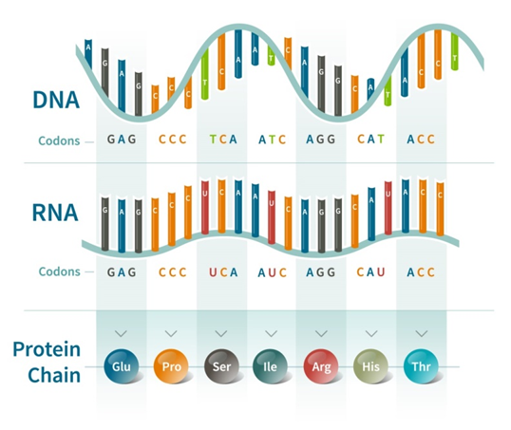

Slide 25
Amino acids
The building blocks for proteins. All amino acids contain an amino or NH₂ group and a carboxyl (acid) or COOH group.
There are 20 different amino acids commonly found in proteins and often 300 or more amino acids per protein molecule.
Each amino acid differs in terms of its "R" group. The "R" group of an amino acid is the remainder of the molecule, that is, the portion other than the amino group, the acid group, and the central carbon. Each different amino acid has a unique "R" group and the unique chemical properties of an amino acid depend on that of its "R" group

Slide 26
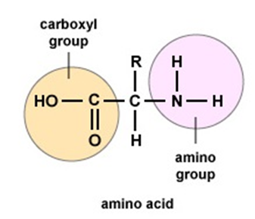
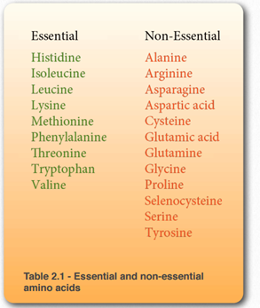
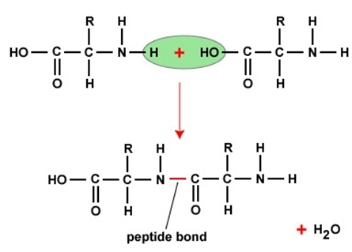

Slide 27
A codon
A sequence of three nucleotides on a strand of DNA or RNA. Each codon is like a three-letter word, and all of these codons together make up the DNA (or RNA) instructions..
The three codons that do not code for amino acids are called stop codons. They serve as the stop signal that tells the ribosome that it has come to the end of the protein instructions and to stop adding amino acids. In RNA, the nucleotide base thymine (T) is replaced by the nucleotide base uracil (U).

Slide 28
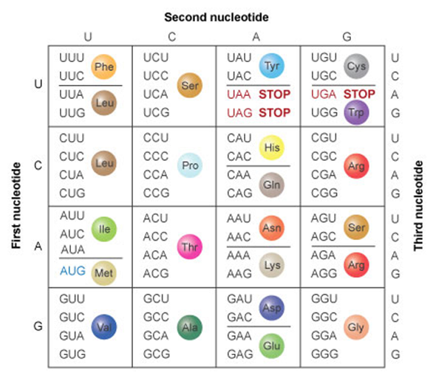

Slide 29
Genetic code
The information transferred or passed from the parent generation to the offspring is called genetic code. The process begins at the cellular level when the genes get split into the parental reproductive cells and then get united to form a hybrid set of genes during fertilization.
Characteristics of the Genetic Code
The genetic code is universal. All known living organisms use the same genetic code. ...
The genetic code is unambiguous. Each codon codes for just one amino acid (or start or stop). ...
The genetic code is redundant. Most amino acids are encoded by more than one codon.

Slide 30
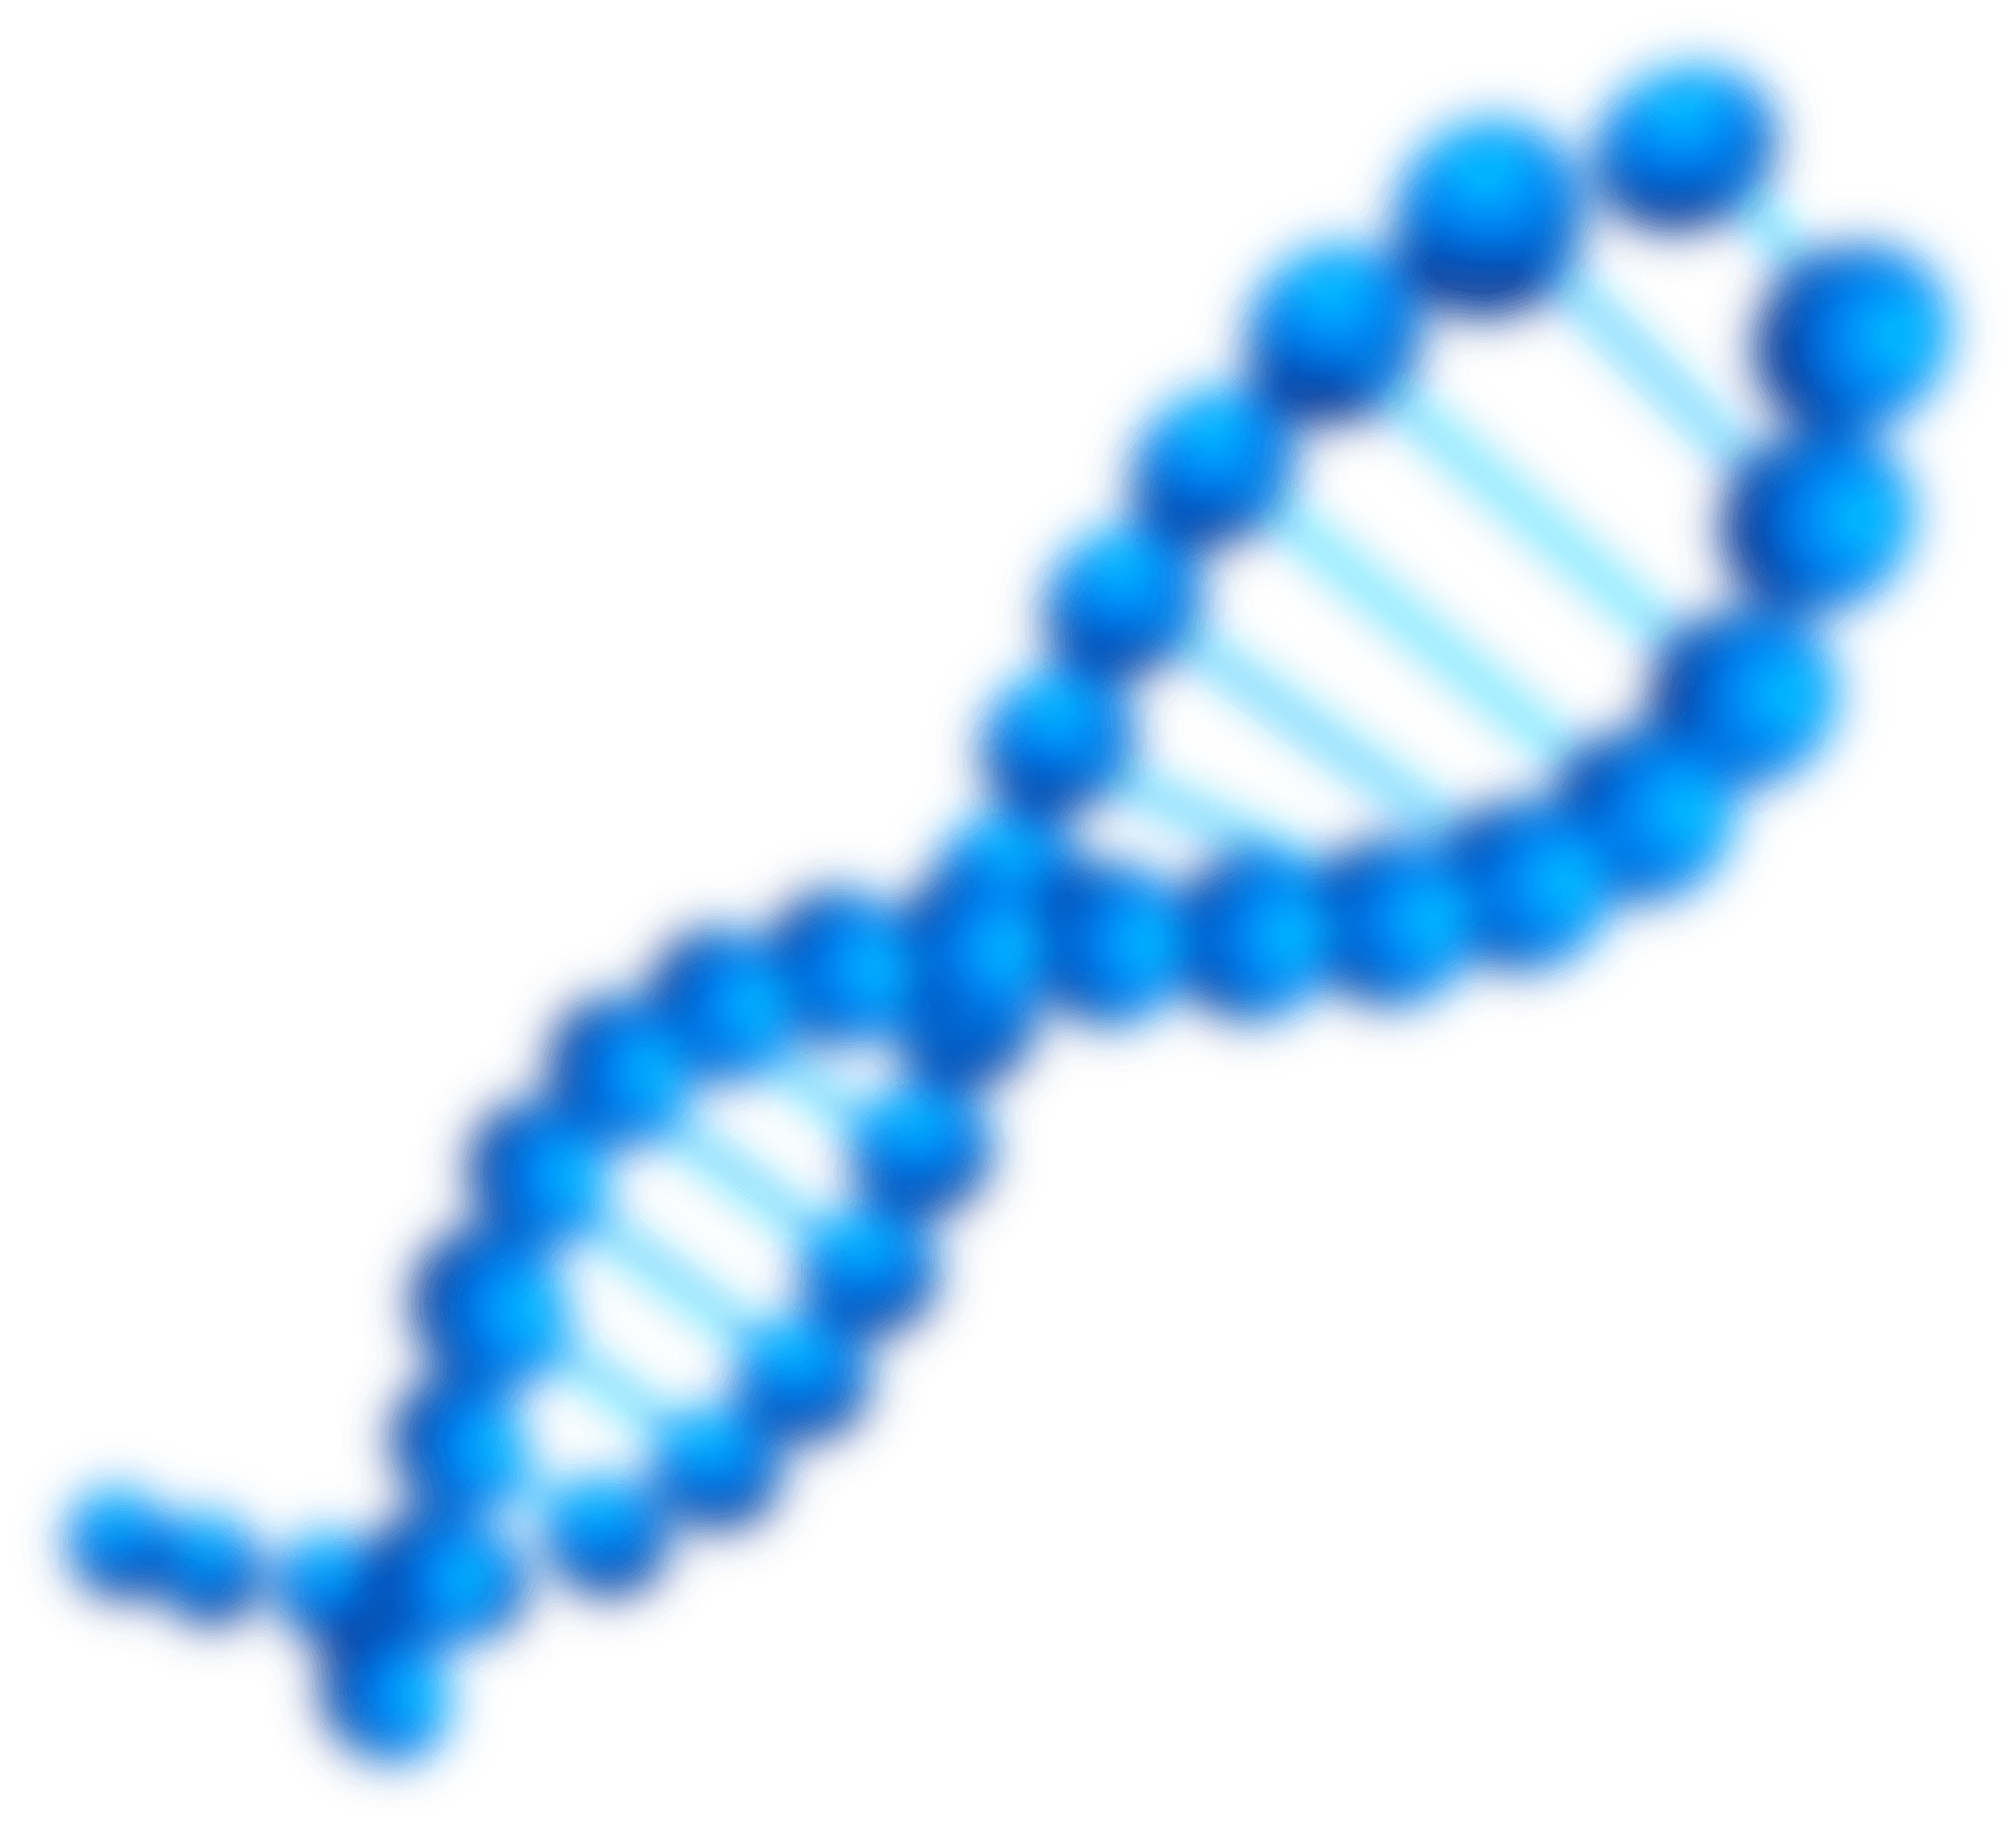
#---Get protein code---
#List of sequence of mRNA
mRNA = ['AUG', 'CCG', 'UAU']
# Protein Function -- know protein from mRNA sequence
def get_protein(rna):
seq_protein = " "
for i in rna:
if i == "AUG":
seq_protein += "Met \t"
elif i == "CCG":
seq_protein += "Pro \t"
elif i == "UAU":
seq_protein += "Tyr "

Slide 31
else:
print("Invalid protein")
return seq_protein
#Sequence of Protein
seq_protein = get_protein(mRNA)
print('The Sequence of protein is [' + seq_protein + ']')

Slide 32
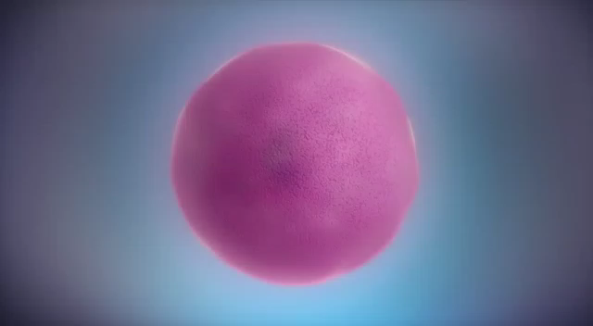
Video

Slide 33
Practical project

Slide 34
#---DNA to protein---
# --- Open 3 files ---
# File has sequences of DNA
dna_file = open("DNA", "r+")
# Empty file for mRNA sequences
mRNA_file = open("mRNA_Sequence", "w")
# Empty file for proteins sequences
protein_file = open("protein", “w")
seq_DNA = dna_file.read()

Slide 35
#---Transcription function---
def transcription(dna):
mRNA = " "
# Make mRNA sequences
for i in dna:
if i == 'A':
mRNA += 'U'
elif i == 'T':
mRNA += 'A'
elif i == 'C':
mRNA += 'G'
elif i == 'G':
mRNA += 'C'
elif i == ' ':
mRNA += ' '
else:
print("Invalid")
return mRNA

Slide 36
#--- Write mRNA sequences in mRNA file ---
seq_mRNA = transcription(seq_DNA)
mRNA_file.write(seq_mRNA)

Slide 37
#--- Translation function ---
def translate(seq):
# Dictionary has proteins codons
table = {
'ATA': ' Ile ', 'ATC': ' Ile ', 'ATT': ' Ile ', 'ATG': ' Met ',
'ACA': ' Thr ', 'ACC': ' Thr ', 'ACG': ' Thr ', 'ACT': ' Thr ',
'AAC': ' Asn ', 'AAT': ' Asn ', 'AAA': ' Lys ', 'AAG': ' Lys ',
'AGC': ' Ser ', 'AGT': ' Ser ', 'AGA': ' Arg ', 'AGG': ' Arg ',
'CTA': ' Leu ', 'CTC': ' Leu ', 'CTG': ' Leu ', 'CTT': ' Leu ',
'CCA': ' Pro ', 'CCC': ' Pro ', 'CCG': ' Pro ', 'CCT': ' Pro ',
'CAC': ' His ', 'CAT': ' His ', 'CAA': ' Gin ', 'CAG': ' Gin ',
'CGA': ' Arg ', 'CGC': ' Arg ', 'CGG': ' Arg ', 'CGT': ' Arg ',
'GTA': ' Val ', 'GTC': ' Val ', 'GTG': ' Val ', 'GTT': ' Val ',
'GCA': ' Ala ', 'GCC': ' Ala ', 'GCG': ' Ala ', 'GCT': ' Ala ',
'GAC': ' Asp ', 'GAT': ' Asp ', 'GAA': ' Glu ', 'GAG': ' Glu ',
'GGA': ' Gly ', 'GGC': ' Gly ', 'GGG': ' Gly ', 'GGT': ' Gly ',
'TCA': ' Ser ', 'TCC': ' Ser ', 'TCG': ' Ser ', 'TCT': ' Ser ',
'TTC': ' Phe ', 'TTT': ' Phe ', 'TTA': ' Leu ', 'TTG': ' Leu ',
'TAC': ' Tyr ', 'TAT': ' Tyr ', 'TAA': '-', 'TAG': '-',
'TGC': ' Cys ', 'TGT': ' Cys ', 'TGA': '_', 'TGG': ' Trp ',
}

Slide 38
#--- Translation function cont. ---
protein = "“
if len(seq) % 3 == 0:
for i in range(0, len(seq), 3):
codon = seq[i:i + 3]
protein += table[codon]
return protein

Slide 39
#--- Write protein sequences in protein file ---
seq_protein = translate(seq_DNA)
protein_file.write(seq_protein)
#--- Close all file ---
mRNA_file.close()
protein_file.close()
dna_file.close()
#--- End of project ---

Slide 40
Team member
Name | Role
Abdel-wahab Mohamed Abdo Basiony | Practical Project & Introduction
Ahmed Ibrahim Abdel-hafeez El-kholy | Practical Project & Video
Shaimaa Karam Mostafa Ali | Transcription of DNA
Salma Magdy Mohamed Ahmed | Translation of DNA
Shrouk El-Sayed Ahmed Helal | Protein

Slide 41
references
https://stackoverflow.com/questions/50031180/dna-to-rna-transcription-code-in-python-3-6-failing-acgtxxxcttaa-test
https://www.geeksforgeeks.org/dna-protein-python-3/
(PDF) Transcription and translation (researchgate.net)

Slide 42
Thank You

